Slide 1
Generative Adversarial Networks
Deep Learning CA 2 – Part A
Terry Boo Chee Yee (P2211194) | Li Sheng (P2309110)
DAAA/FT/2B/22

Slide 2
00
Overview

Slide 3
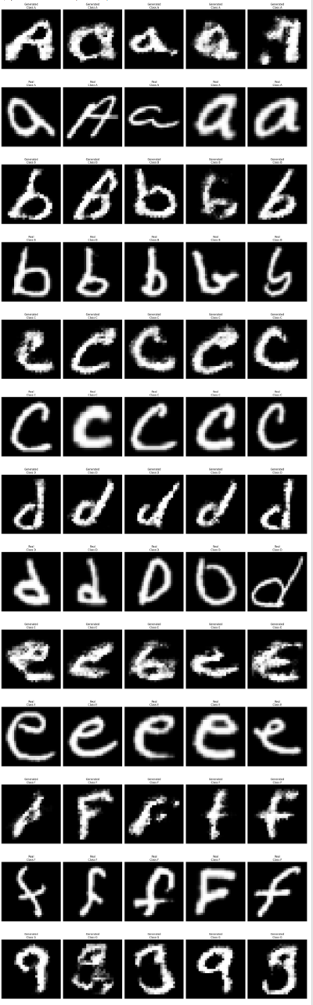
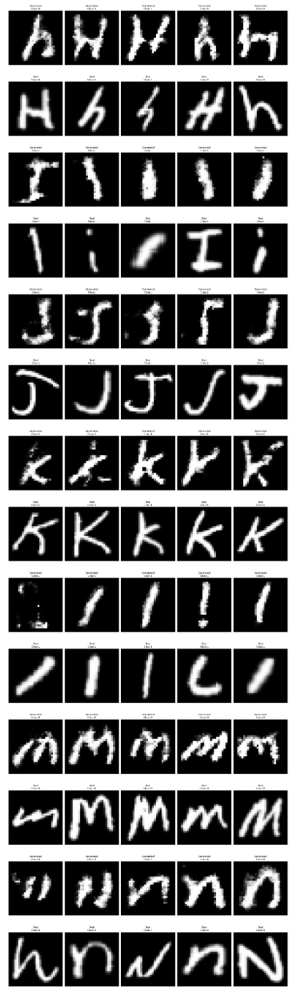
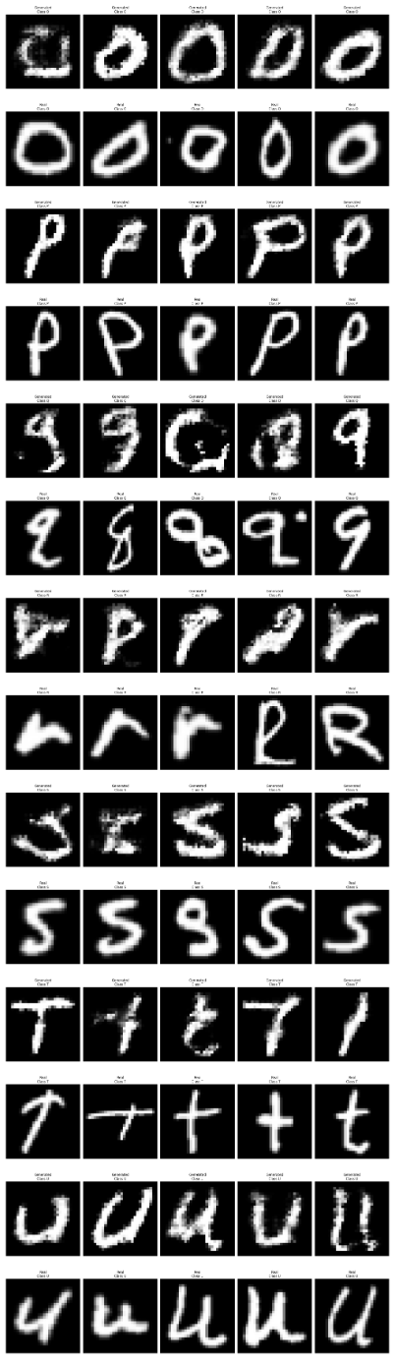
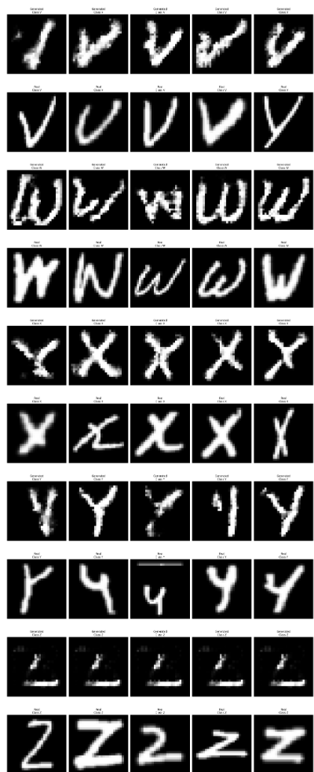
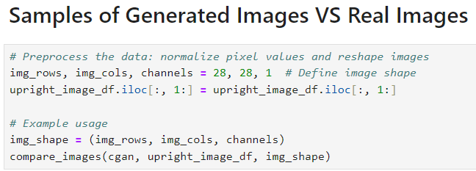
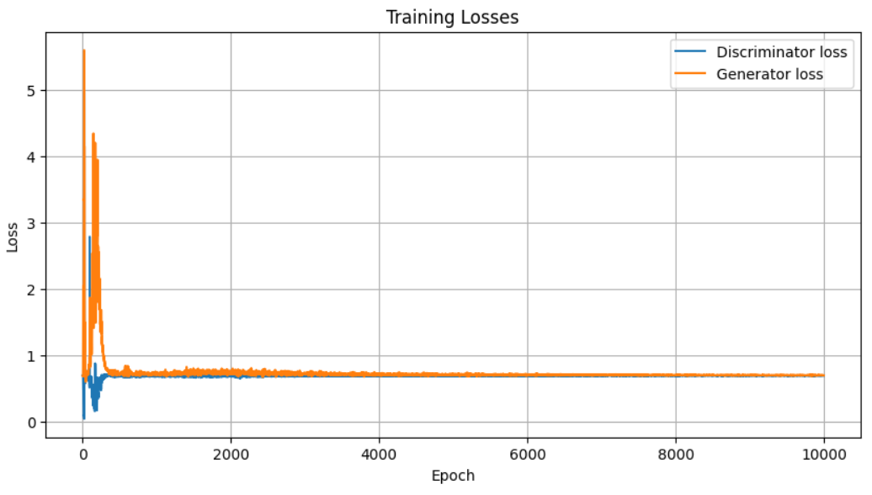
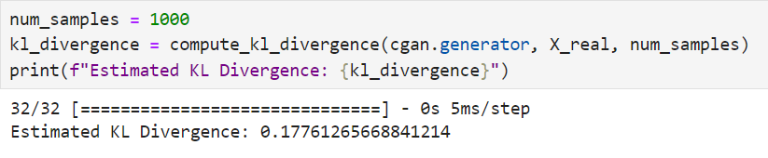
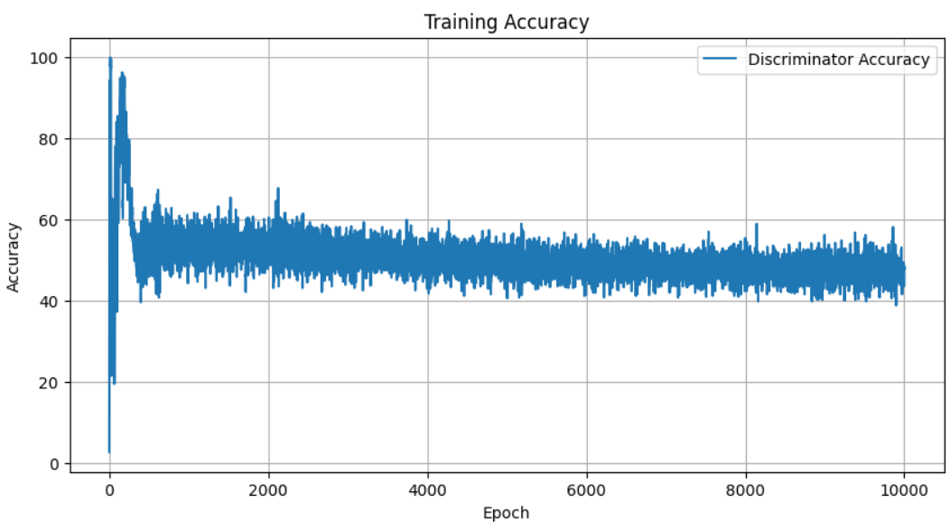
Final CGAN Performance
KL Divergence of 0.1776
High quality of images generated for most class
Converging loss suggesting generator is improving
Classes A, C, D, E, F, I, J, K, L, N, O, P, R, S, T, U, V, and X have sharp and well-defined features, showing the generator's strong ability to produce high-quality images.
Classes B, Y, W, Q, M, H, and G have details that are not that well captured.
Class Z has significant issues, highlighting areas where the Generator's performance is lacking.
The generator's loss decreases and stabilizes around 0.7 after 200 epochs, while the discriminator's loss increases and stabilizes around 0.7, indicating the generator is improving.
Accuracy starts at 100% and decreases, fluctuating between 40% and 60%, reflecting the generator's improved ability to produce realistic images.
A value of 0.1776 shows the generator's success in mimicking the real data distribution, capturing essential features and variations.
Together, these metrics form a comprehensive evaluation framework that allows us to understand the strengths and weaknesses of our GAN model. The consistency in generated image quality for most classes, the balanced training losses, and the relatively low KL Divergence all point to a generally well-performing model.
In conclusion, our GAN model demonstrates strong potential, with effective learning for most classes and a balanced training dynamic.

Slide 4
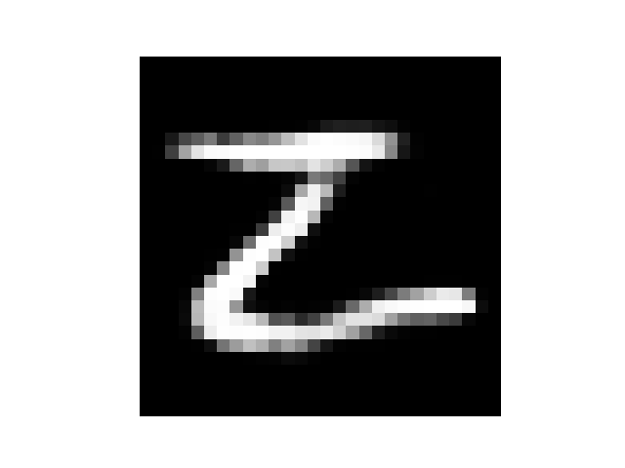
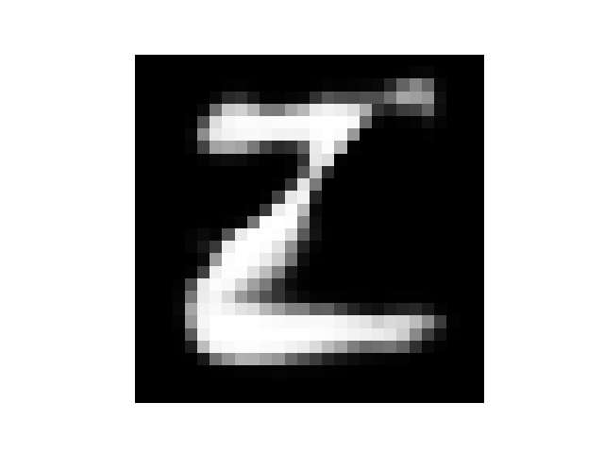
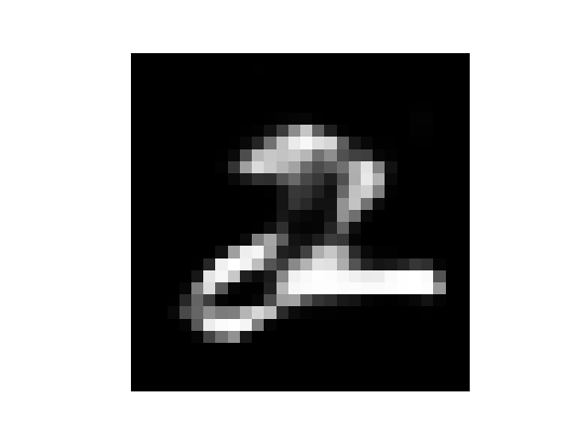
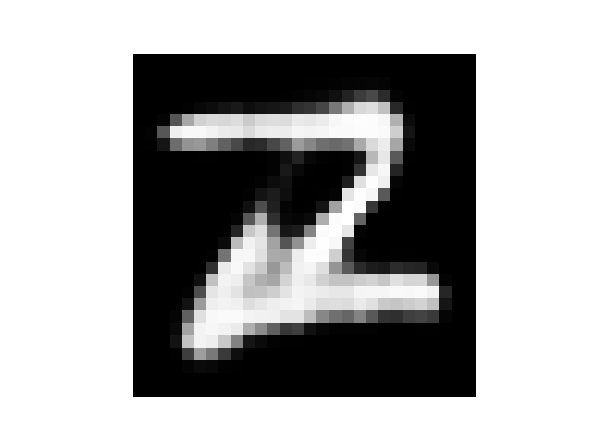
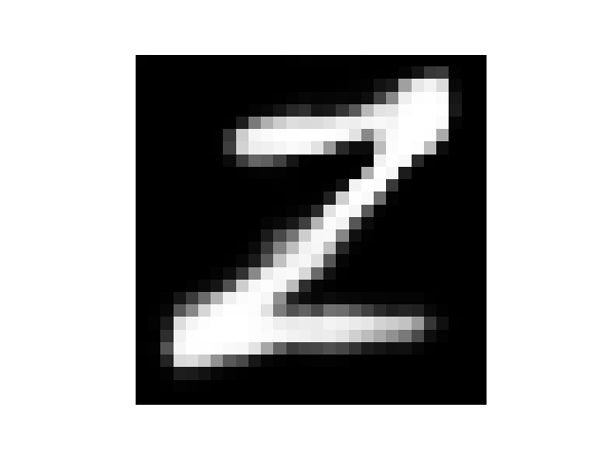
The ‘Z’ Problem
Previously
Solution: DCGAN for Class “Z”
DCGAN generates images without class labels, simplifying training for "Z" without additional complexity.
Training DCGAN on "Z" images allows the model to specialize, producing higher-quality images for that class.
Results in Enhanced clarity and structure in generated "Z" images.
Results in Improved samples of generated "Z" images, showcasing better quality
Previously, the generator is not generating the Z class well
We will use our final CGAN model and this additional DCGAN model to generate the 260 images (10 images/class)
Results

Slide 5
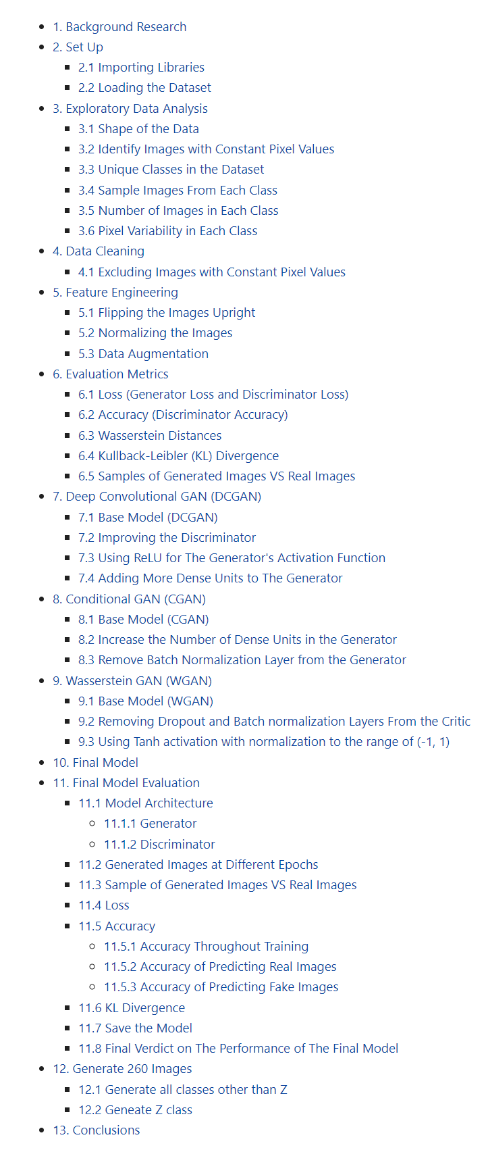
Summary of the process we went through (Workflow)
1. EDA
7. Final Model Evaluation (CGAN)
2. Data Cleaning
Excluding Images with Constant Pixel Values
Model Architecture
Sample of generated images VS real images
Loss
Accuracy
KL divergence
Final Verdict
3. Feature engineering
Flipping the Images Upright
Normalizing the Images (to [0 1])
Data Augmentation
4. DCGAN (With tunning)
5. CGAN (With tunning)
8. Generate the Images
6. WGAN (With tunning)

Slide 6
Process to obtain the best CGAN Model
1. Base Model
2. Increase the Number of Dense Units in the Generator
3. Remove Batch Normalization Layer from the Generator
By increasing the number of units (neurons) in this layer, we increase the capacity of the generator to learn and capture more complex patterns and features from the input noise vector. This allows the generator to potentially model more intricate relationships and variations in the data distribution it aims to mimic.
Batch normalization (BN) layers are typically used to stabilize and speed up the training of neural networks by normalizing activations and reducing internal covariate shift. In the context of GANs, the training dynamics can be quite sensitive, and batch normalization might interfere with the adversarial training process.

Slide 7
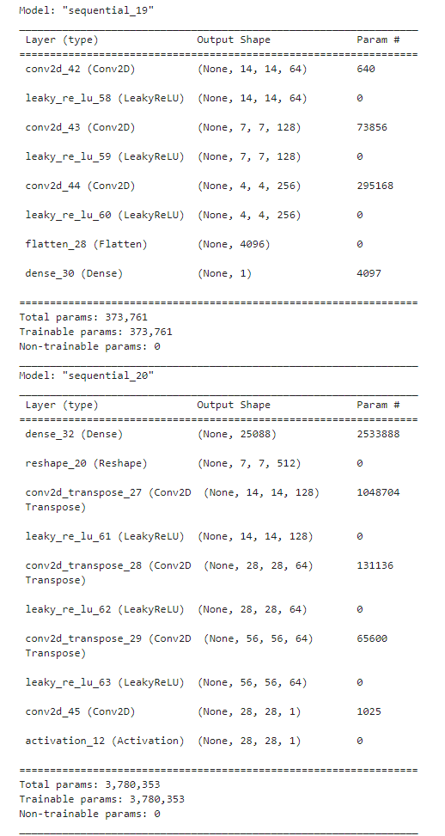
Configuration of Final CGAN Model
Generator
Discriminator
Conv2D Layer: 64 filters, kernel size 3, strides 2, activation function: LeakyReLU (alpha=0.2)
Conv2D Layer: 128 filters, kernel size 3, strides 2, activation function: LeakyReLU (alpha=0.2)
Conv2D Layer: 256 filters, kernel size 3, strides 2, activation function: LeakyReLU (alpha=0.2)
Flatten Layer
Dense Layer: 1 neuron, activation function: Sigmoid
Dense Layer: 512 * 7 * 7 neurons, activation function: ReLU
Reshape Layer: output shape (7, 7, 512)
Conv2DTranspose Layer: 128 filters, kernel size 4, strides (2, 2), activation function: LeakyReLU (alpha=0.2)
Conv2DTranspose Layer: 64 filters, kernel size 4, strides (2, 2), activation function: LeakyReLU (alpha=0.2)
Conv2DTranspose Layer: 64 filters, kernel size 4, strides (2, 2), activation function: LeakyReLU (alpha=0.2)
Conv2D Layer: channels filters, kernel size 4, strides (2, 2), activation function: Sigmoid

Slide 8
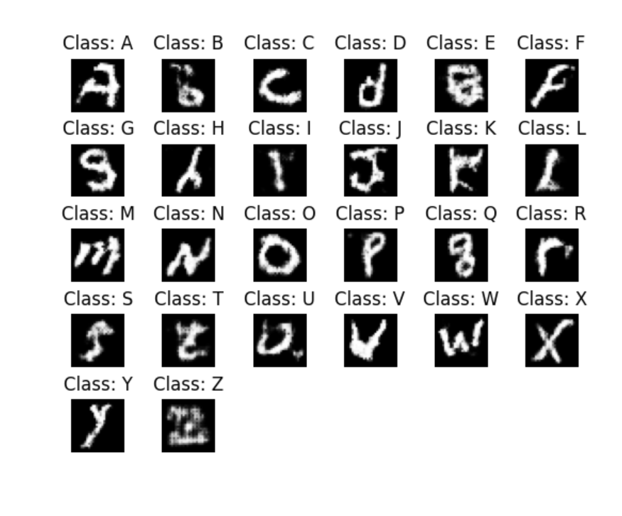
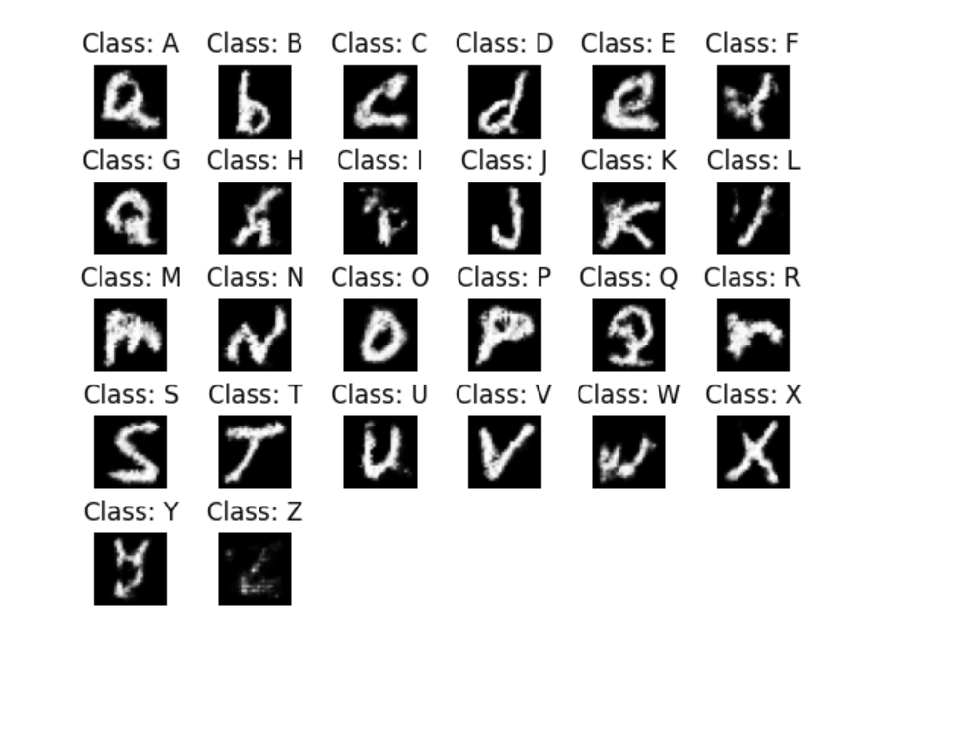
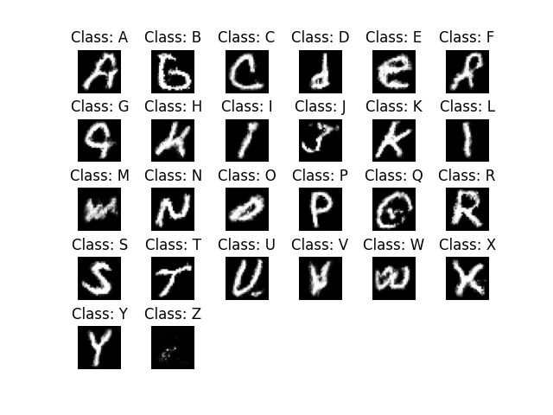
Image Quality Progression of Final Model (CGAN)
Base Model
Increase the Number of Dense Units in the Generator
Remove Batch Normalization Layer from the Generator

Slide 9
Process to obtain the best DCGAN Model
3. Using ReLu for the generator's activation function
1. Base Model
2. Improve the discriminator
From the baseline model, it is evident that the GAN is not generating images effectively. While some letters are partially represented, many others are not recognizable at all. To address this issue, we decided to enhance the discriminator. By strengthening the discriminator's ability to differentiate between real and generated images, we aim to provide more precise feedback to the generator. This improved feedback will help the generator refine its outputs and create more realistic and diverse representations of handwritten letters. Ultimately, our goal is to achieve higher-quality image generation, ensuring that each letter is accurately represented in the final dataset.
Despite the improved quality of the images generated in the previous model, the generator is still struggling to learn the image patterns effectively, resulting in some blurry images with patches of white. Therefore, we have decided to use ReLU to enhance the learning process. By incorporating ReLU, we aim to leverage its properties to better capture the intricate details of the images and improve the overall clarity and realism of the generated outputs.
4. Adding more dense unit to the generator
We increased the number of dense units for the generator to enhance its capacity to learn and represent complex patterns in the data. With more dense units, the generator can capture a greater variety of features and nuances, which is essential for producing high-quality, detailed images..

Slide 10
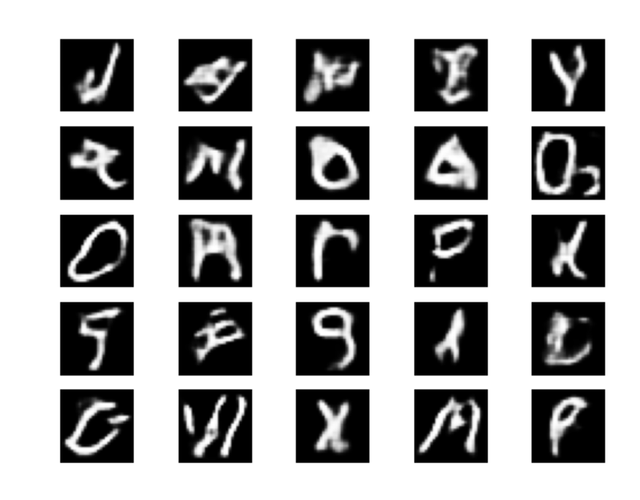
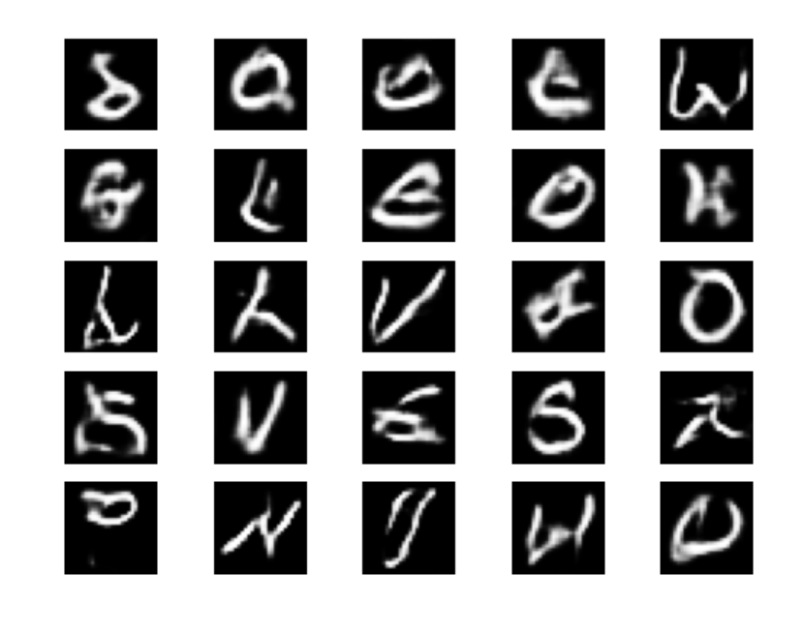
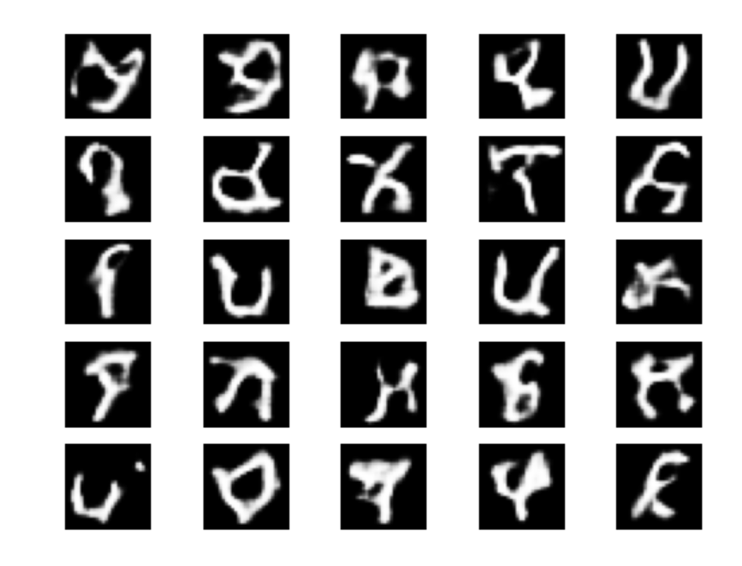
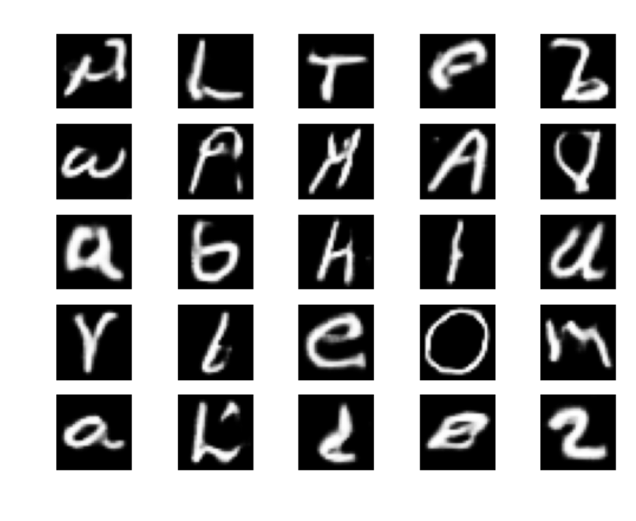
Image Quality Progression of DCGAN Model
Base Model
Improve the discriminator
Using ReLu for the generator's activation function
Adding more dense unit to the generator

Slide 11
Process to obtain the best WGAN Model
1. Base Model
2. Removing dropout and batch normalization layer from the generator
3. Using TanH activation with normalization to the range of (-1, 1)
Normalizing the input data to the range of (-1, 1) and using Tanh activation functions can significantly benefit the learning process. Tanh activation, which outputs values in the range (-1, 1), aligns well with the normalization range, ensuring that the data is centered around zero.
This can help in maintaining a stable training process by avoiding issues like saturation and vanishing gradients, which are common with activations that output larger ranges.
Tanh activation function encourages stronger gradient signals compared to the sigmoid function, especially when inputs are centered around zero. This can lead to more efficient and faster convergence during training, ultimately improving the quality of the generated images.
Removing dropout and batch normalization layers can lead to more stable gradient updates. Dropout, while useful in regular neural networks to prevent overfitting, can introduce noise and instability in the gradients, which might disrupt the delicate balance required for effective WGAN training.

Slide 12
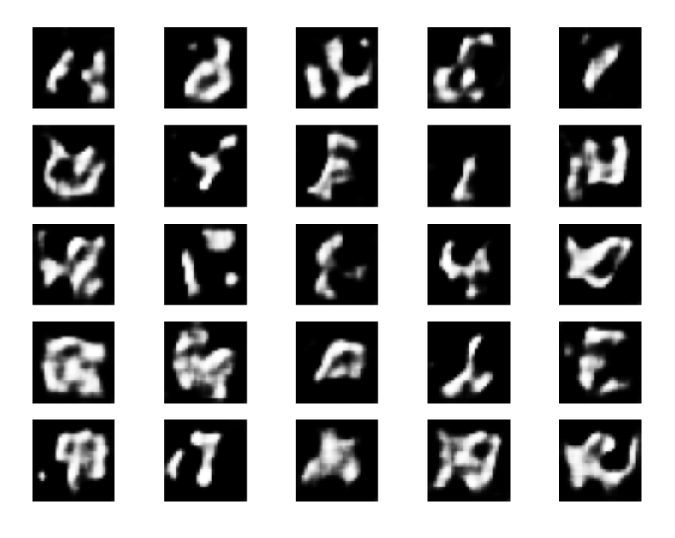
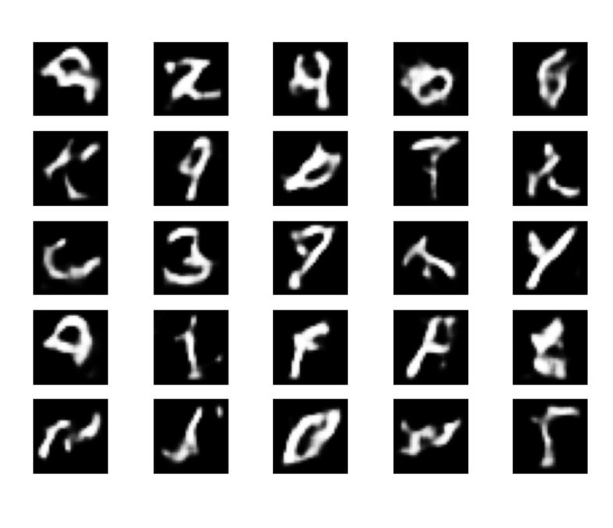
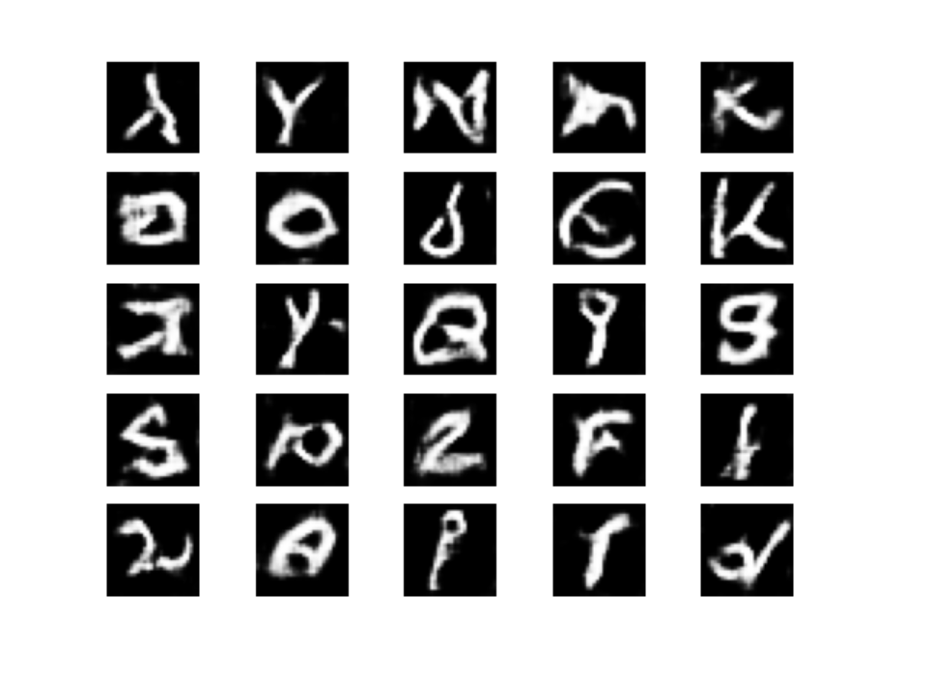
Image Quality Progression of WGAN Model
Base Model
Removing dropout and batch normalization layer from the generator
Using TanH activation with normalization to the range of (-1, 1)

Slide 13
Table of contents
01
02
03
04
05
06
07
Background
Exploratory Data Analysis
Data Cleaning
Data Preprocessing
Evaluation Metrics
Modelling
Final Model
08
Conclusion

Slide 14
01
Background

Slide 15
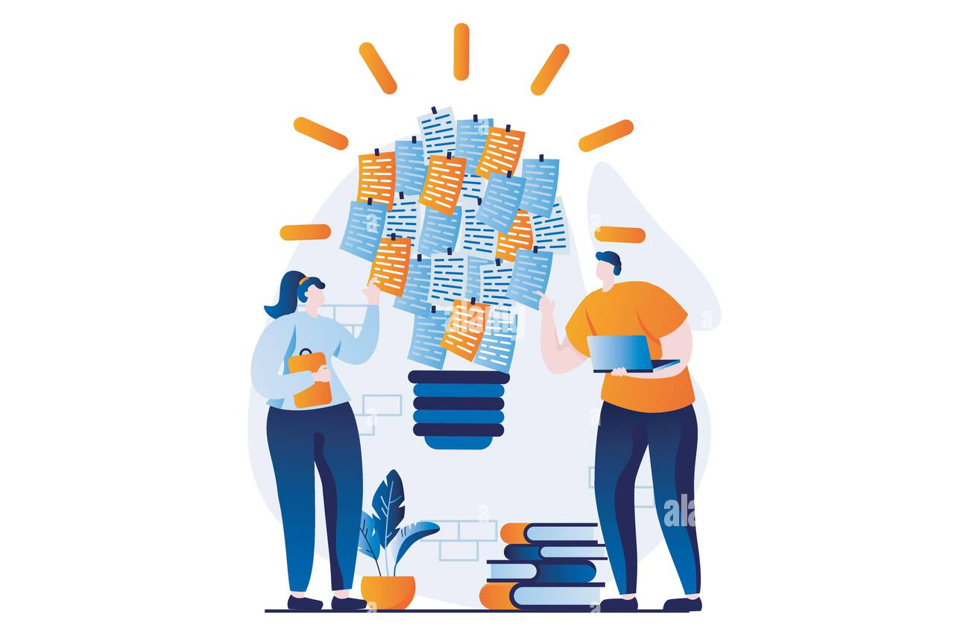
Task & Solution
Task
In our project, we aim to create 260 small black-and-white images of handwritten letters using the EMNIST Letters dataset. This task involves several key steps, including data cleaning, feature engineering, model selection, training the GAN, fine-tuning the GAN, evaluation, and image generation.
Solution
In our project, we will explore various types of Generative Adversarial Networks (GANs) to generate 260 small black-and-white images of handwritten letters from the EMNIST Letters dataset. Each GAN variant comes with its own advantages and disadvantages, which we will weigh to determine the best-performing model for our task.
Alexdndz (no date)

Slide 16
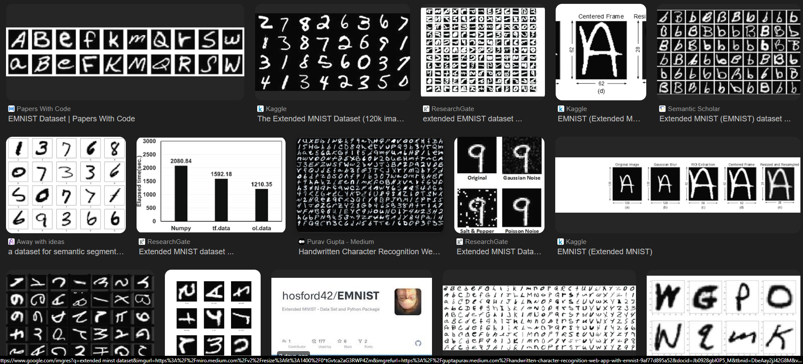
About the Dataset
The EMNIST Letters dataset contains 26 classes, corresponding to the 26 letters of the English alphabet (A-Z).
Similar to the MNIST dataset, the images in EMNIST are grayscale and of size 28x28 pixels. Each pixel value is an integer between 0 and 255, where 0 represents a black pixel and 255 represents a white pixel.
The labels for the images are numeric values from 1 to 26, corresponding to the letters A-Z.
Google search on EMNIST dataset

Slide 17
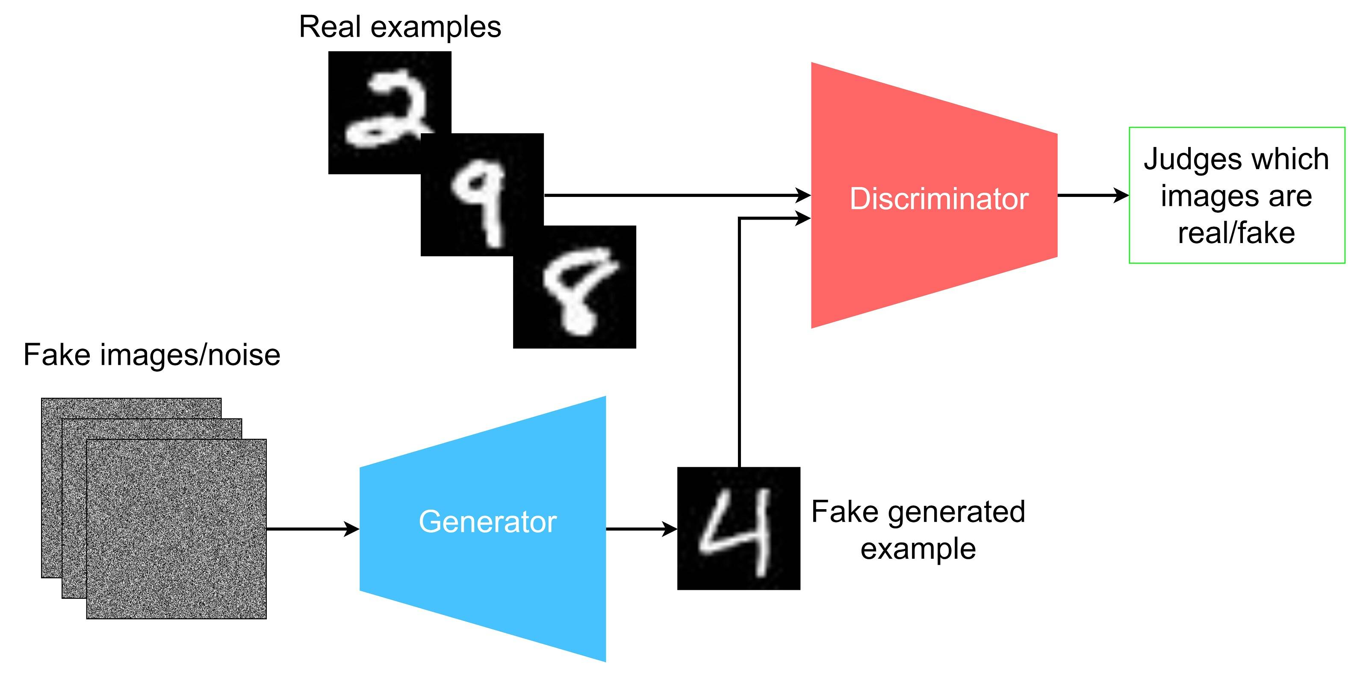
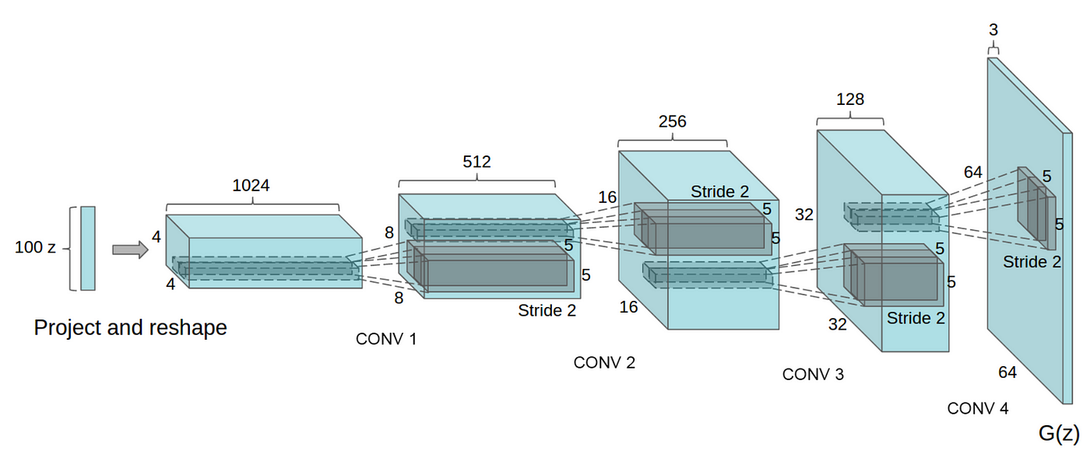
What are GANs
What are GANs
Generative modelling is an unsupervised learning task in machine learning that involves automatically discovering and learning the regularities or patterns in input data in such a way that the model can be used to generate or output new examples that plausibly could have been drawn from the original dataset.
How Gan works
Discriminator: The discriminator in a GAN is simply a classifier. It tries to distinguish real data from the data created by the generator. It could use any network architecture appropriate to the type of data it's classifying.
Generator: The generator part of a GAN learns to create fake data by incorporating feedback from the discriminator. It learns to make the discriminator classify its output as real.
First, the generator creates samples from random noise inputs and feeds these generated samples into the discriminator. The discriminator then tries to classify whether each sample is real (from the actual data distribution) or generated (fake).
Components in a GAN model (Hansen, 2022)
Stacking conv layers (Chablani, 2017)

Slide 18
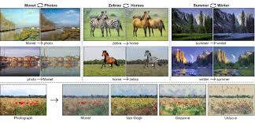
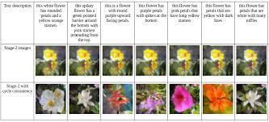
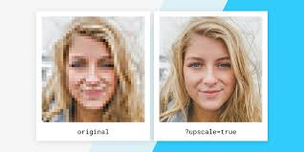
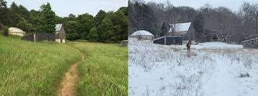
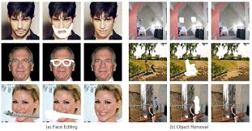
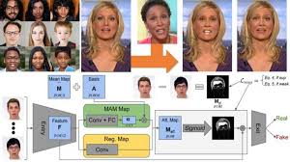
Applications of GAN
Image-to-Image Translation
GANs can translate images from one domain to another, such as converting sketches to realistic images, day images to night images, and black-and-white images to colour images. This has applications in fields like computer graphics and virtual reality.
Text-to-Image Translation
GANs (Generative Adversarial Networks) are increasingly used in text-to-image translation, where they generate detailed and contextually accurate images based on textual descriptions. This technology is particularly useful in creative industries, allowing artists and designers to visualize concepts from textual input.
Super Resolution
Super Resolution Generative Adversarial Networks (SRGANs) are highly effective in enhancing the resolution of images, significantly increasing their clarity and detail. This can be particularly useful in several areas, such as improving the resolution of medical scans for better diagnosis, enhancing the quality of surveillance footage for clearer identification, and improving satellite images for more detailed geographical and environmental analysis.
Photograph Editing
GANs are widely utilized in photograph editing to enhance and transform images through various innovative tasks. For instance, they can effectively replace the background of a photograph with an entirely different scene, making it easier to create composites or adjust the context of an image. Additionally, GANs can change facial attributes, allowing for modifications such as altering expressions, changing hairstyles, or even aging or de-aging subjects. Furthermore, they enable the modification of specific attributes of objects within photos, such as changing the colour of a car, altering the texture of a building, or modifying clothing in fashion images.
Photo Inpainting
GANs (Generative Adversarial Networks) are employed in photo inpainting to restore missing parts of an image or remove unwanted objects by generating content that seamlessly blends with the surrounding areas. They are particularly effective in filling gaps in damaged photographs, removing unwanted elements, and reconstructing incomplete parts of images.
Deep Fake
GANs are a key technology in the creation of deepfakes, which are realistic audio and video forgeries. By leveraging the capabilities of GANs, creators can generate highly convincing synthetic media that can swap faces in videos, create realistic lip-syncing, or even simulate a person's voice. In entertainment, deepfakes can be used for special effects in films, allowing for seamless integration of actors into various scenes without extensive makeup or CGI.

Slide 19
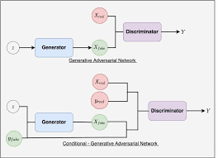
If you are asked to generate images of a specific class, propose a way of doing it
We can use Conditional GAN (CGAN). Conditional GANs are an extension of standard GANs and consist of two main components: the generator and the discriminator. Unlike a typical DCGAN, where the generator only takes in a noise vector (random input) and the discriminator only determines whether the image is real or generated, the generator in CGANs takes both a noise vector and a class label as inputs to generate an image corresponding to the specified class. Similarly, the discriminator takes both an image and a class label as inputs to determine whether the image is real (from the dataset) or generated (by the generator).
During the training process of a CGAN, a noise vector and a class label are fed into the generator to produce a synthetic image corresponding to the given class. Real images from the dataset, paired with their class labels, are then combined with the generated images and labels. The discriminator is trained on this mixed set, learning to distinguish between real and generated images. This process involves calculating the loss for both real and fake images and updating the discriminator's weights accordingly. After training the discriminator, the generator is trained to fool the discriminator by generating images that appear real. This is done by freezing the discriminator's weights and updating the generator's weights based on the discriminator's feedback. The generator's loss is calculated based on how well it can generate images that the discriminator classifies as real. This cycle continues for many iterations, gradually improving both the generator's ability to produce realistic images and the discriminator's ability to distinguish real from fake images, with the added conditional element allowing for class-specific image generation.
In conclusion, CGANs are trained on additional information such as class labels, thus allowing them to generate images based on specific classes.
Components in a GAN model (TankUs, 2023)

Slide 20
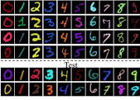
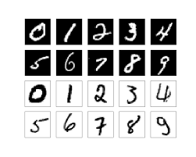
If you are asked to generate coloured images instead of black-and-white ones, do you think it would be easier or harder to produce better quality results
It would be harder to produce better quality of coloured images.
Coloured images have three channels (Red, Green, and Blue) compared to the single channel in black-and-white images. This increase in dimensionality means the model has to learn more detailed and complex patterns.
The complexity of coloured images can exacerbate training instability, making it harder to achieve convergence and maintain consistent performance.
The increased complexity in the images means increased computational requirements, which can lead to longer training times and a need for more powerful hardware.
Accurately representing how light interacts with coloured surfaces is more complex compared to black-and-white images. Coloured images require the model to handle reflections, shadows, and colour bleeding effects, which add layers of complexity that are not present in black-and-white images, where light interactions are simpler and often rely on shades of Gray.
Colored vs black and white MNIST

Slide 21
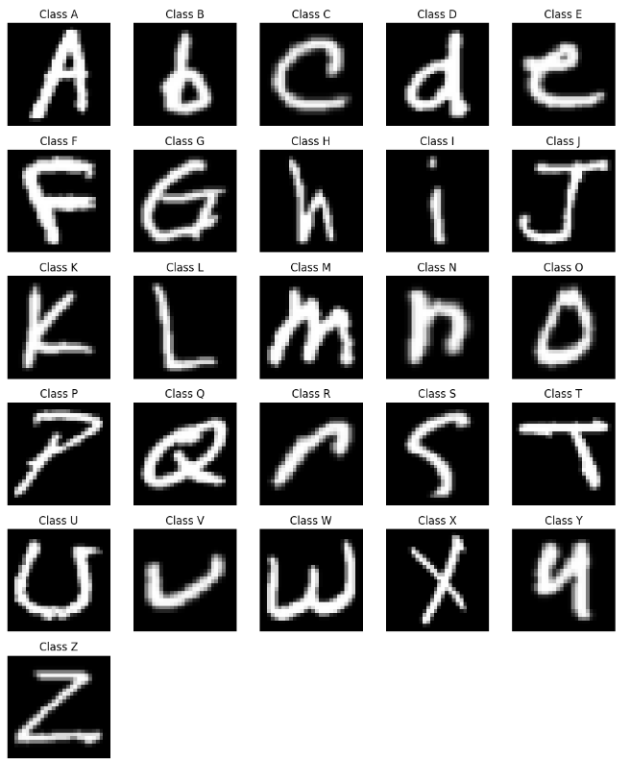
What class(es) is/are relatively easier/harder to generate? Why?
Classes that are relatively easier to generate
Straightforward (e.g., "I", "L", "O")
These letters have simpler shapes and fewer strokes, making them less complex for the GAN to learn. Additionally, they typically have more consistent representations in handwriting, reducing variability.
Letters where lowercase and uppercase forms are similar (e.g., "C", "O", "V", "K", "P", "U")
Letters in which uppercase and lowercase forms maintain the same basic shape, with size as the primary difference, allow the GAN to learn a consistent representation without needing to adapt to drastically different forms. The minimal structural differences also result in fewer variations in how these letters can be written, reducing the complexity the GAN must manage.
Classes that are relatively harder to generate
Complex Letters (e.g., "S", "G", "Q")
These letters often have more intricate curves and loops, which can introduce greater variability in styles and representations. The added complexity can challenge the GAN's ability to generate accurate samples.
Letters with variability in different handwriting styles (e.g., "A")
The same letter can look very different depending on individual writing styles, leading to variations in structure and positioning. When a letter can have multiple forms, the GAN must learn to generate a wider range of structures and styles. This complexity requires the model to capture more nuanced features, which can be challenging.
All classes in the Dataset

Slide 22
02
Exploratory Data Analysis

Slide 23
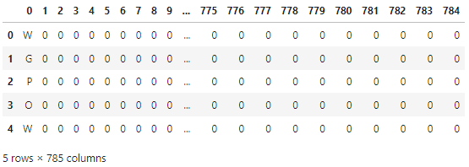
About the dataset
EMNIST Dataset
This dataset comprises 99,040 images with 785 columns, where the first column represents the class label, and the subsequent columns contain pixel values.
Identify Images with Uniform Pixel Values
Images with uniform pixel values are those where all the pixel values are the same across the entire image.
Uniform pixel values result in an image that is a single, solid colour with no variation or detail, which may not provide any useful information for analysis or training.
The dataset includes 10,240 images with uniform pixel values, all categorized under the '-1' class.

Slide 24
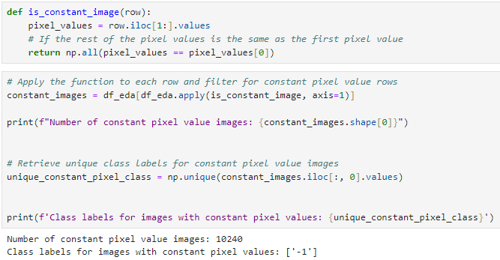
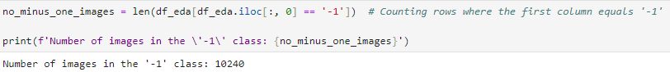
Identify Images with Constant Pixel Values
What are constant pixel values
Constant pixel values, when referred to in the context of an entire image, mean that every pixel in the image has the same value. This results in a completely uniform image without any variation in colour or intensity.
Results
The dataset includes 10,240 images with uniform pixel values, all categorized under the '-1' class.
Since there are 10,240 images in the '-1' class, all the images in the '-1' class are images with uniform pixel values
We will take note of the images with uniform pixel values during the Data Cleaning process

Slide 25
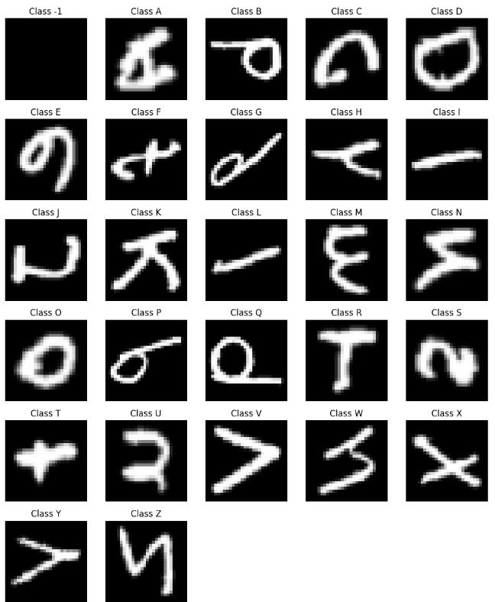
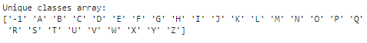
Unique Classes in the Dataset
The Dataset contains images of A - Z class and there is a '-1' class.
Looks like the images are representing their labels correctly, but they are not oriented in an upright position. In addition, the '-1' class contains images of solid colours.

Slide 26
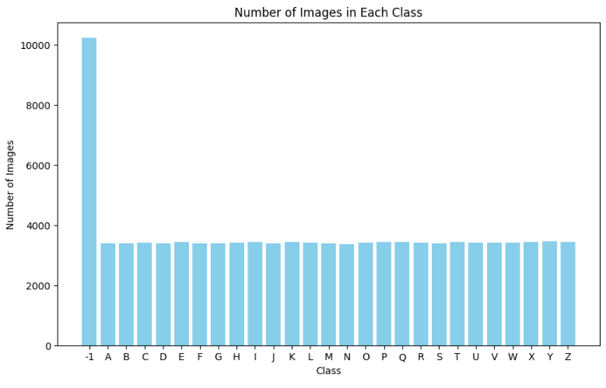
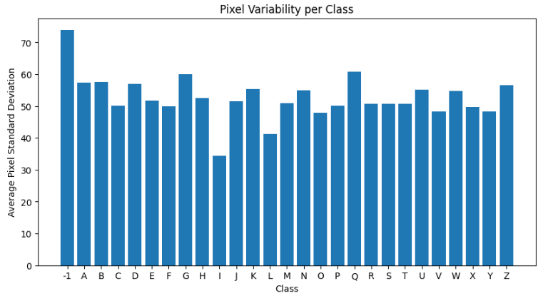
Number of Images & Pixel Variability in each class
Number of Images
There are approximately 10,000 images in the '-1' class, whereas the other classes each have around 3,700 images.
Pixel Variability
Variations in pixel standard deviation could reflect differences in how the features of each class are represented. For example, certain letters may have more diverse writing styles leading to higher pixel variability.
Classes with significantly lower or higher pixel variability (e.g., 'Q', 'G', and '-1') might be outliers. This can indicate either unique features within those classes or potential issues with data quality or labelling.
Results
The '-1' class exhibits the highest pixel variability, whereas the 'I' class shows the least variability.
We don't need to be concerned about pixel variability because we will normalize the images during the Feature Engineering step. Normalization will ensure that the pixel values are scaled properly for training.

Slide 27
03
Data Cleaning

Slide 28
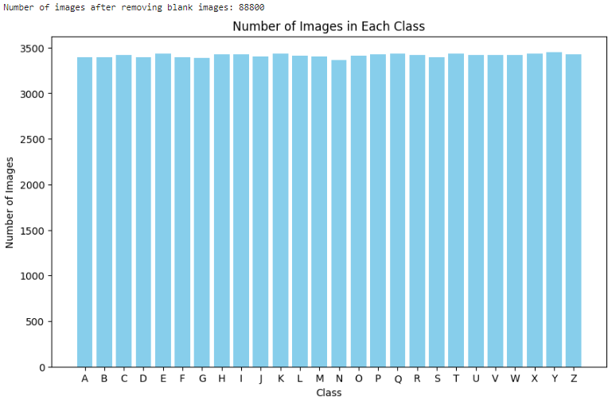
Excluding Images with Constant Pixel Values
Why do we exclude images with constant pixel values
Images with constant pixel values lack variability and do not provide any meaningful features or patterns that can be used for training models. They do not contribute to learning useful representations.
Including such images can reduce the efficiency of training processes. The model might spend unnecessary computation cycles processing these uninformative images, which can slow down the overall training process.
In datasets where variability is crucial (e.g., object detection, classification, or segmentation), constant pixel value images act as noise. They do not help in learning the distribution of the target data and can lead to suboptimal performance.
Steps:
Dropped the constant pixel value images
Total number of images 99,040 -> 88,800
The number of images in each class is now relatively balanced with a few variability within each class.

Slide 29
04
Data Preprocessing

Slide 30
Flipping the images upright
What we realised
We have realised that the images are flipped vertically and are rotated 90 degree anti clockwise
Why do we have to flip the images upright
GANs generate images based on learned patterns from the training data. If the images are flipped or rotated, the model will learn incorrect associations, leading to unrealistic outputs (Images generated will not be upright too).
What will we do to flip the images upright
We will first flip the images vertically and next rotate the images 90 degrees clockwise

Slide 31
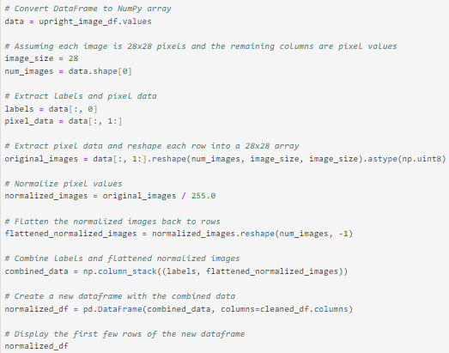
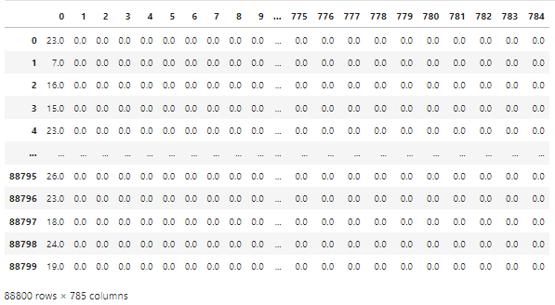
Normalizing the Images
What is Normalizing the Images
Normalizing images refers to the process of adjusting the pixel values of the images to a common scale such as [0, 1] or [-1, 1].
Why did we normalize the images
Normalization helps standardize the pixel values, allowing the GAN to learn patterns more effectively.
Normalized inputs can lead to more stable training, reducing issues like vanishing or exploding gradients.
Normalization prevents the model from being overly influenced by the absolute values of pixel intensities, helping it focus on the relative features of the images.
What we did
We have normalized the images to a [0, 1] scale

Slide 32
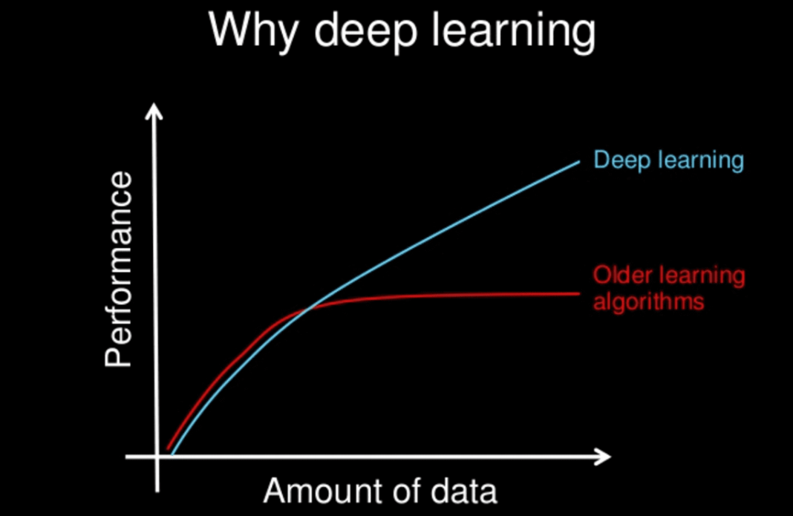
Data Augmentation
What is data augmentation
Data augmentation is a technique used to artificially increase the size of a training dataset by applying various transformations to the existing data samples. These transformations include rotations, translations, flips, changes in brightness and contrast, cropping, and more. This diversify the training data and expose the model to a wider range of variations.
Why did we augment the dataset
Data augmentation introduces variations in the training images, allowing the GAN to learn more robust features and reducing the risk of overfitting. Additionally, augmented images make the GAN more resilient to variations in input, such as changes in orientation and scale. By exposing the GAN to various transformations, it can learn to generate more diverse and realistic images, ultimately improving the quality of its outputs.
Steps taken to augment the data
Resample the train dataset and put the resampled images into a Data Frame
Define an Image Data Generator to Augment the data
Augment the data
Combine the augmented data with the original train dataset
Andrew Ng, 2019

Slide 33



Data Augmentation
Target
To handle class imbalance in normalized_df we augment the dataset to achieve a target number of images per class (target_per_class = 3500).
Number of images in each class
Number of images needed for each class

Slide 34
05
Evaluation Metrics

Slide 35

Loss (Generator Loss and Discriminator Loss)
Generator Loss
The generator loss measures how well the generator is performing in producing realistic images that can fool the discriminator. It is calculated based on the discriminator's feedback for the images generated by the generator. The goal of the generator is to minimize this loss, which means it aims to improve its ability to create images that the discriminator classifies as real.
Discriminator Loss
The discriminator loss evaluates how effectively the discriminator can distinguish between real and generated images. It is calculated by measuring the discriminator's accuracy in classifying real images from the training dataset as real (label 1) and the generated images as fake (label 0). The discriminator aims to minimize this loss, enhancing its ability to accurately differentiate between real and generated images.
Optimal Values
For optimal performance, both losses should be balanced. If the generator loss is significantly lower than the discriminator loss, it suggests that the generator is dominating the training, while if the discriminator loss is very low, it may indicate that the generator is struggling to produce convincing images.

Slide 36

Accuracy (Discriminator Accuracy)
What discriminator accuracy measures
Discriminator accuracy reflects the model's ability to correctly identify real images as real (label 1) and generated images as fake (label 0).
Balance in Training
Ideally, the discriminator's accuracy should fluctuate during training. This fluctuation indicates that the generator is effectively challenging the discriminator, contributing to a balanced training process where both components of the GAN improve.

Slide 37

Wasserstein Distances
What is Wasserstein Distances
Wasserstein distance, also known as Earth Mover's Distance (EMD), is a measure of the distance between two probability distributions. It quantifies how much "work" is needed to transform one distribution into another, considering the distribution's underlying geometry.
What is Wasserstein Distances used for
Wasserstein GANs (WGANs) represent an improvement over traditional GANs by utilizing Wasserstein distance as their loss function, which enhances the stability of the training process. This approach effectively addresses common challenges faced in GAN training, such as mode collapse, where the generator produces a limited variety of outputs, and the vanishing gradient problem, which can hinder the learning of the generator and discriminator.

Slide 38


Kullback-Leibler (KL) Divergence
What is KL Divergence
Kullback-Leibler divergence metric (relative entropy) is a statistical measurement from information theory that is commonly used to quantify the difference between one probability distribution from a reference probability distribution.
The divergence between two probability distributions quantifies how much the two differ from each other.
How is KL Divergence used to evaluate GANs
GANs aim to generate samples that resemble the true data distribution. KL divergence can quantify how well the distribution of generated samples matches the distribution of real data.
By comparing the distributions of generated and real samples, we can compute KL divergence to assess the fidelity and diversity of the generated samples.
What is 'Good' Value for Kullback-Leibler (KL) Divergence
KL divergence is a measure of difference between distributions and does not have a standardized scale. The value of KL divergence depends on the specific distributions being compared and their variability.
Typically, in GANs, the goal of the generator is to minimize the KL divergence between the distribution of generated samples and the distribution of real data. A lower KL divergence indicates that the generator is producing samples that closely match the real data distribution in terms of statistical properties. Therefore, from this perspective, a lower value of KL divergence is considered better.
Formula for KL Divergence

Slide 39

Samples of Generated Images VS Real Images
What will we be doing
To compare real and generated images side by side, we place samples from both datasets next to each other to assess how closely they resemble each other visually, their overall quality, and how well they capture the characteristics of the original data distribution.
Criteria
Evaluate how clear and detailed the images are. Real images typically have sharp details, and generated images should strive to match this quality.
Look for any distortions, blurriness, or unnatural patterns in the generated images that are not present in real images.
Look for diversity among generated images. A good generator should produce a variety of images that cover different aspects of the data distribution, rather than repeating a few similar patterns

Slide 40
06
Modelling

Slide 41

Deep Convolutional GAN (DCGAN)
How Deep Convolutional GAN Works
The generator starts with a random noise vector, typically sampled from a Gaussian or uniform distribution. This noise vector is fed through a series of deconvolutional (transposed convolutional) layers, which progressively upsample and refine it into a realistic image. The goal of the generator is to produce images that are indistinguishable from real ones.
On the other hand, the discriminator takes an image as input, which can either be a real image from the training dataset or a fake image generated by the generator. This image is processed through a series of convolutional layers that downsample it and extract key features, helping the discriminator learn to distinguish between real and fake images. The discriminator outputs a probability score indicating whether the image is real or fake.
The Training Process of Deep Convolutional GAN
First, real images are fed into the discriminator, and its weights are updated to maximize the probability of correctly identifying them as real. Next, generated images are fed into the discriminator, and its weights are updated to minimize the probability of incorrectly identifying them as real. This ensures the discriminator becomes better at distinguishing real images from generated ones.
After updating the discriminator, the generator is trained. During this step, the discriminator's weights are typically frozen to prevent them from being updated based on the generator's training. The generator's loss is calculated based on the discriminator's feedback, specifically aiming to minimize the probability of the discriminator correctly identifying generated images as fake.

Slide 42

DCGAN (Base)
Main Components of Deep Convolutional GAN (base)
Generator Network
Input Layer: The input layer accepts a noise vector (latent space) typically sampled from a normal distribution.
Dense Layer: The dense layer transforms the noise vector into a higher-dimensional space
Reshape Layer: The reshape layer reshapes the dense layer output into a 3D tensor (height, width, channels)
Upsampling Layer: The upsampling layer increase the spatial dimensions of the input tensor (height and width) while keeping the number of channels the same
Convolutional Layer: The convolutional layer apply convolutional filters to the upsampled tensor to generate feature maps. These layers help in refining the upsampled image and adding more details
Batch Normalization Layer: The batch normalization layer normalize the outputs of the convolutional layers to improve training stability and performance
Activation Functions: Activation functions introduce non-linearity to the network, allowing it to learn more complex patterns
Discriminator Network
Convolutional Layer: The convolutional layer extract features from the input image. Each filter within the layer learns to detect specific patterns or features, such as edges, textures, shapes, or more complex structures, by convolving with the input data. Ultimately it converts the image into numerical values, allowing the neural network to interpret and extract relevant patterns
Leaky ReLU Activation: The leaky ReLU activation introduce non-linearity into the network, allowing it to learn more complex patterns. The Leaky ReLU helps prevent the dying ReLU problem by allowing a small gradient when the unit is not active.
Dropout Layer: The dropout layer prevent overfitting by randomly setting a fraction of input units to 0 during training. This forces the network to learn more robust features.
Flatten Layer: Convert the 3D tensor output from the convolutional layers into a 1D vector, which can be fed into a dense layer
Dense Layer (Output): Perform the final classification by producing a single scalar output. This output is passed through a sigmoid activation function to produce a probability

Slide 43



DCGAN (Base) Evaluation
Training Losses
Initially, the generator loss is quite high, around 0.9, while the discriminator loss is relatively low, around 0.5. As training progresses, the generator loss decreases, and the discriminator loss increases, eventually converging with both losses around 0.7. This trend suggests that the generator is improving in generating more realistic samples over time, while the discriminator is finding it increasingly challenging to distinguish between real and generated data. When both losses stabilize around a similar value, it often indicates that the GAN has reached a balance, with the generator producing sufficiently realistic data that the discriminator cannot easily differentiate from real data.
Accuracy
The discriminator's accuracy starts very high, around 99%, and gradually decreases, fluctuating between 55% and 60%. This pattern suggests that initially, the discriminator can easily distinguish between real and generated data, as the generator's outputs are not yet realistic. However, as the generator improves, it becomes harder for the discriminator to differentiate, leading to a decrease in accuracy. The fluctuation around 55% to 60% indicates that the discriminator is no longer confidently distinguishing between real and fake samples, suggesting that the generator is producing more convincing outputs.
Generated Images
From the generated images, we can see that certain classes like T, U, X, D, and N are more recognizable. However, most classes are still not very clear, indicating that the generator hasn't yet fully captured the distinctions needed to accurately reproduce all the different classes.
In summary, the GAN has shown significant progress as evidenced by the combination of training losses, discriminator accuracy, and image quality. Although some generated classes are recognizable, the varying quality of the images suggests that the generator is still refining its ability to accurately reproduce all class distinctions. To further improve the quality of the generated images, we plan to experiment with improving the discriminator.

Slide 44

DCGAN (Improving Discriminator)
What is the impact of the discriminator in GANs
The discriminator evaluates whether an image is real (from the training dataset) or fake (generated by the generator). This assessment helps ensure that the generator produces more realistic outputs over time.
The discriminator's performance directly influences the training dynamics of the GAN. A strong discriminator can effectively guide the generator to improve, while a weak discriminator may lead to mode collapse, where the generator produces limited variations of images.
A well-balanced discriminator can help stabilize the training process. If the discriminator is too strong compared to the generator, it may lead to vanishing gradients, making it difficult for the generator to learn. Conversely, if the generator outperforms the discriminator, the latter may not provide useful feedback.
What changed from the previous model
1 additional conv2D layer for the discriminator
1 additional dense layer after the flatten layer for the discriminator
Why did we choose to improve the discriminator
From the baseline model, it is evident that the GAN is not generating images effectively. While some letters are partially represented, many others are not recognizable at all. To address this issue, we decided to enhance the discriminator. By strengthening the discriminator's ability to differentiate between real and generated images, we aim to provide more precise feedback to the generator. This improved feedback will help the generator refine its outputs and create more realistic and diverse representations of handwritten letters. Ultimately, our goal is to achieve higher-quality image generation, ensuring that each letter is accurately represented in the final dataset.

Slide 45



DCGAN (Improving Discriminator) Evaluation
Training Losses
Initially, the generator loss is quite high, around 4, while the discriminator loss is relatively low, around 0.2. As training progresses, the generator loss decreases, and the discriminator loss increases, eventually converging with both losses around 0.7. This trend suggests that the generator is improving in generating more realistic samples over time, while the discriminator is finding it increasingly challenging to distinguish between real and generated data. When both losses stabilize around a similar value, it often indicates that the GAN has reached a balance, with the generator producing sufficiently realistic data that the discriminator cannot easily differentiate from real data.
Accuracy
The discriminator's accuracy starts very high, around 99%, and gradually decreases, fluctuating between 50% and 60%. This pattern suggests that initially, the discriminator can easily distinguish between real and generated data, as the generator's outputs are not yet realistic. However, as the generator improves, it becomes harder for the discriminator to differentiate, leading to a decrease in accuracy. The fluctuation around 50% to 60% indicates that the discriminator is no longer confidently distinguishing between real and fake samples, suggesting that the generator is producing more convincing outputs.
Generated Images
The generated images have shown visual improvement, with more classes becoming recognizable. Classes such as R, I, Y, M, O, G, and X are now clearer and easier to distinguish.
In summary, the GAN's performance has improved notably over time. Initially, the generator's high loss and the discriminator's low loss indicated that the generator struggled to produce realistic samples. Additionally, the quality of generated images has improved, with more classes becoming clearer and recognizable. To further improve the quality of the generated images, we plan to experiment with using ReLU for our activation function.

Slide 46

DCGAN (Using ReLU)
What is ReLU activation function
The ReLU (Rectified Linear Unit) activation function is a popular non-linear activation function used in neural networks, particularly in deep learning models. The output of ReLU is zero for any negative input and equal to the input for positive values. This results in outputs ranging from 0 to infinity.
ReLU introduces non-linearity into the model, allowing the generator to learn complex mappings from the latent space to the image space. This is essential for generating high-quality, realistic images.
ReLU's output is zero for negative inputs, leading to sparse activations. This sparsity can improve model performance and reduce the risk of overfitting by encouraging the generator to focus on the most relevant features.
What changed from the previous model
Generator's activation function is changed from Leaky ReLU to ReLU
Difference between ReLU can Leaky ReLU
ReLU and Leaky ReLU differ in several key aspects for the generator in a GAN. ReLU outputs zero for negative values, while Leaky ReLU provides a small, non-zero output for negative inputs. In terms of gradient flow, ReLU has a gradient of 1 for positive inputs, whereas Leaky ReLU maintains a small gradient for negative inputs.
Why did we use ReLU for the Generator's Activation Function
Despite the improved quality of the images generated in the previous model, the generator is still struggling to learn the image patterns effectively, resulting in some blurry images with patches of white. Therefore, we have decided to use ReLU to enhance the learning process. By incorporating ReLU, we aim to leverage its properties to better capture the intricate details of the images and improve the overall clarity and realism of the generated outputs.

Slide 47



DCGAN (Using ReLU) Evaluation
Training Losses
Initially, the generator loss is high, around 3, while the discriminator loss is low, around 0.3. As training progresses, the generator loss decreases and the discriminator loss increases, converging around 0.7. This indicates that the generator is getting better at producing realistic samples, making it harder for the discriminator to distinguish between real and generated data. The stabilization of losses suggests that the GAN has reached a balance.
Accuracy
The discriminator's accuracy starts at 99% but gradually decreases, fluctuating between 50% and 60%. This trend shows that as the generator improves, the discriminator finds it increasingly difficult to differentiate between real and fake samples, indicating the generator's outputs are becoming more convincing.
Generated Images
The generated images have improved in terms of sharpness. Previously, some of the images produced were quite blurry, but after changing the activation function of the generator, the images are now visually sharper. This change has helped the model produce clearer and more defined images, making the different classes easier to distinguish. This improvement in image quality suggests that the new activation function better captures the complex patterns and details require.
Together, these metrics highlight a balanced progression where the generator's advancements in producing realistic and sharp images are matched by the discriminator's increasing challenge in distinguishing between real and generated data, ultimately showcasing the effectiveness of the model's improvements. To further improve the quality of the generated images, we plan to experiment with adding more dense units to generator.

Slide 48

DCGAN (Adding More Dense Units to Generator)
What changed from the previous model
Dense units in the first Dense layer of the generator increased from 128 to 1500
Number of epochs increased from 3000 to 10000
Why did we increase the number of dense units for the generator
We increased the number of dense units for the generator to enhance its capacity to learn and represent complex patterns in the data. With more dense units, the generator can capture a greater variety of features and nuances, which is essential for producing high-quality, detailed images.
Why did we increase the number of epochs
From the previous models, we observed that 3000 epochs were insufficient for the generator to fully learn the underlying patterns in the data. By increasing the number of epochs to 10000, we aim to provide the model with more training time to refine its outputs and improve image quality. This extended training period allows the generator to better capture the complexities of the dataset, leading to more realistic and detailed images.

Slide 49




DCGAN (Adding More Dense Units to Generator) Evaluation
Training Losses
The training loss curve reveals that the generator's loss starts very high, around 2.5, while the discriminator's loss begins relatively low at approximately 0.3. As training progresses, both losses converge to around 0.7. However, after 4000 epochs, the generator's loss begins to increase, while the discriminator's loss decreases significantly. Eventually, the generator's loss stabilizes around 0.8, and the discriminator's loss flattens at about 0.6.
Accuracy
The accuracy curve shows that the discriminator begins with a very high accuracy of about 99%, which then drops and fluctuates between 40% and 60%. After 4000 epochs, the accuracy improves slightly and stabilizes around 50% to 60%.
Generated Images
After adding more dense units to the generator and increasing the number of epochs, the generated images have become sharper, making more classes easily identifiable. In the generated images, we can clearly see classes like T, E, Z, W, A, Y, H, I, U, B, O, M, and Z. This improvement demonstrates that the adjustments have enhanced the quality and diversity of the generated samples, making it easier to distinguish between different classes.
The clearer distinction of classes in the generated images aligns with the trend in training losses and accuracy, demonstrating that the modifications to the generator have enhanced both the quality and diversity of the outputs. To further improve the quality of the generated images, we plan to experiment with using CGAN instead of DCGAN which is likely to provide benefits in terms of generating class-specific images, improving training stability, and increasing the flexibility of the image generation process.

Slide 50

Conditional GAN (CGAN)
What is Conditional GAN
CGANs is a type of Generative Adversarial Network that adds additional information into both the generator and the discriminator to condition the generation process. This additional information can be any type of label or structured data such as class labels, images or other data that helps the generation process.
It allows the generator to create more controlled and contextually appropriate outputs by using the additional information given to it.
Difference between CGANs and DCGANs
CGANs uses additional information as conditions into the generation process while DCGANs focus on using convolutional networks for better performance in image data.
CGANs are used for tasks that need controlled generated based on the input conditions while DCGANs are used for generating high-quality, realistic images.
CGANs defining feature is the conditioning mechanism while DCGANs specifically use deep convolutional networks for both the generator and discriminator, emphasizing the architecture rather than conditioning.
How Conditional GAN Works
In a CGAN, both the generator and the discriminator receive additional information, such as class labels or attributes, which guide the image generation process. This allows the model to create images that not only resemble real data but also match specified conditions, providing greater control over the output.
The generator in a cGAN takes two inputs: random noise, typically sampled from a normal distribution, and a conditioning variable that represents the desired outcome, such as a class label. This generator learns to produce synthetic images that correspond to the given condition.
Similarly the discriminator also receives both real images and generated images, along with their respective conditions. Its role is to determine whether an image is real or fake, taking the condition into account, and it outputs a probability indicating how likely the image is to be real given that condition.

Slide 51

CGAN (Base)
Training Process of Conditional GAN
During each training iteration, the discriminator is trained using a mixed batch containing both real images from the training dataset and generated images produced by the generator, along with their corresponding condition labels. This mixed batch allows the discriminator to simultaneously evaluate and compare real and synthetic samples. After calculating the loss for both real and generated samples, the discriminator's weights are updated to improve its classification accuracy in distinguishing between authentic and generated images while considering the conditional inputs.
Next, the generator is trained by feeding it random noise and the conditional inputs, aiming to maximize the discriminator’s error on the generated images. To facilitate this process, it is common to freeze the weights of the discriminator while training the generator, preventing it from adapting too quickly and allowing the generator to learn more effectively from the feedback. Conversely, when the discriminator is being trained, the generator's weights are frozen. This alternating training helps stabilize the learning dynamics, ensuring that neither component overpowers the other.
Over multiple iterations, both networks improve, ultimately resulting in high-quality, class-specific image generation.

Slide 52



CGAN (Base) Evaluation
Training Losses
The initial high loss of around 17 for the generator and the low loss of approximately 0.4 for the discriminator suggest that the generator's early outputs were highly unrealistic, while the discriminator was initially effective at distinguishing between real and generated images. As training progressed, the generator's loss decreased to around 3.6, indicating an improvement in image quality, while the discriminator's loss increased to about 1, reflecting the growing challenge of distinguishing between real and fake images. Eventually, both losses converged to around 0.7, suggesting a balance where the generator produced sufficiently realistic images that the discriminator could not easily differentiate.
Accuracy
The discriminator's accuracy started high at around 90% but dropped to approximately 82% before fluctuating between 50% and 60%. This fluctuation suggests that the discriminator became less confident as the generator's outputs improved, making it harder to distinguish between real and generated images.
Generated Images
The generated classes are generally distinguishable, but the images lack sharpness, with noticeable black patches appearing in the alphabets.
The generated images, while improving in distinguishability, reveal issues with sharpness and artifacts, which are consistent with the observed changes in training losses and accuracy. To further improve the quality of the generated images, we plan to experiment with increasing the number of dense units in the generator.

Slide 53

CGAN (Increase the Number of Dense Units in the Generator)
What changed from the previous model
Dense units in the first Dense layer of the generator increased from 128 to 1500
Why did we increase the number of dense units for the generator
The first Dense layer of the generator is responsible for taking the input noise vector (latent space representation) and transforming it into a feature representation that can be further processed by subsequent layers to generate realistic images.
By increasing the number of units (neurons) in this layer, we increase the capacity of the generator to learn and capture more complex patterns and features from the input noise vector. This allows the generator to potentially model more intricate relationships and variations in the data distribution it aims to mimic.

Slide 54



CGAN (Increase the Number of Dense Units in the Generator) Evaluation
Training Losses
The generator's initial high loss of around 14 and the discriminator's low loss of about 0.3 indicate that the generator's early images were unrealistic, while the discriminator was effective at telling real from fake. As training continued, the generator's loss dropped to 5.8, showing improved image quality, while the discriminator's loss rose to 2.1, reflecting increased difficulty in distinguishing images. Both losses eventually converged at 0.7, suggesting a balance where the generator produced realistic images.
Accuracy
The discriminator's accuracy, initially high at 90%, fell to about 80% and then fluctuated between 50% and 60%. This fluctuation indicates that as the generator improved, the discriminator struggled to differentiate between real and generated images.
Generated Images
While more classes are now distinguishable in the generated images, the sharpness still needs improvement. The enhanced recognizability indicates progress in the generator's ability to produce diverse and identifiable characters. However, the images continue to lack detail and clarity.
The improvement in class distinguishability in generated images aligns with the training losses and accuracy trends, demonstrating that while significant progress has been made, further refinement is necessary to achieve higher image quality and clarity. To further improve the quality of the generated images, we plan to experiment with removing batch normalization layer from the generator.

Slide 55

CGAN (Remove Batch Normalization Layer from the Generator)
What changed from the previous model
Batch normalization layer from the generator is removed
Number of epochs increased from 3000 to 10000
Why did we remove batch normalization layer from the generator
Batch normalization (BN) layers are typically used to stabilize and speed up the training of neural networks by normalizing activations and reducing internal covariate shift. In the context of GANs, the training dynamics can be quite sensitive, and batch normalization might interfere with the adversarial training process.
Why did we increase the number of epochs
From the previous models, we observed that 3000 epochs were insufficient for the generator to fully learn the underlying patterns in the data. By increasing the number of epochs to 10000, we aim to provide the model with more training time to refine its outputs and improve image quality. This extended training period allows the generator to better capture the complexities of the dataset, leading to more realistic and detailed images.

Slide 56




CGAN (Remove Batch Normalization Layer from the Generator) Evaluation
Training Losses
The generator's loss fluctuates significantly during the first 1500 epochs, ranging from 4.5 to 23, before steadily decreasing to around 0.7. This fluctuation suggests that the generator's output quality varied widely early in training. Over time, as the generator's performance improved, the loss stabilized around 0.7.
Accuracy
The discriminator’s accuracy, initially high at around 90% for the first 1500 epochs, gradually decreased to a stable range of 50% to 60%. This decline indicates that as the generator improved, it became more challenging for the discriminator to differentiate between real and generated images, leading to a more balanced but less confident prediction.
Generated Images
About 90% of the classes are now distinguishable, and the quality of the images has improved. This is evident from the reduced number of patches in the generated alphabets, indicating clearer and more refined images.
The enhanced quality of generated images, with more classes becoming distinguishable and fewer artifacts, demonstrates the effectiveness of these improvements. Together, these metrics provide a comprehensive view of the GAN’s development, showcasing how advancements in one aspect influence and align with changes in others, leading to more refined and realistic generated images. To further improve the quality of the generated images, we plan to experiment with using WGAN instead of CGAN which is expected to enhance the stability of the training process, improve image quality, increase mode coverage, and yield better performance on standard evaluation metrics.

Slide 57

Wasserstein GAN (WGAN)
What is Wasserstein GAN
Wasserstein Generative Adversarial Network (WGAN) is a variant of the standard GAN that aims to improve the stability of training and the quality of generated samples. WGANs use the Wasserstein distance (also known as Earth-Mover's distance) instead of the Jensen-Shannon (JS) divergence to measure the distance between the real and generated data distributions.
The generator's objective is to minimize the critic's score for the generated samples.
The critic's objective is to maximize the difference between its scores for real and generated samples.
Difference between WGAN and DCGAN
WGAN can use various architectures for the generator and discriminator, similar to DCGAN. However, it requires a different discriminator called a "critic" that does not output probabilities but rather real-valued scores.
WGAN uses the Wasserstein distance instead of the JS divergence.
WGAN improves training stability by clipping the weights of the critic to enforce the Lipschitz constraint, which is required for the Wasserstein distance to be valid.
Why Wasserstein Distance Could Be Better than JS Divergence
Gradient Issues: JS divergence can lead to vanishing gradients when the real and generated distributions do not overlap significantly. The Wasserstein distance, on the other hand, provides meaningful gradients even when the distributions are disjoint, allowing for more stable and continuous training.
Training Stability: The Wasserstein distance has better theoretical properties that contribute to more stable training dynamics. It provides a smoother and more informative measure of the distance between distributions, leading to more reliable updates to the generator.
Mode Collapse: WGANs are less prone to mode collapse, a common problem in standard GANs where the generator produces a limited variety of outputs. The Wasserstein distance helps in maintaining diverse generations by providing better feedback to the generator about the quality of the generated samples.

Slide 58

WGAN (Base)
Initialization and Model Setup
The WGAN class is initialized with parameters specific to the image data being used (28x28 pixels, single channel). The latent_dim parameter represents the dimensionality of the noise vector fed into the generator.
Key hyperparameters include the number of critic updates (n_critic) per generator update and the weight clipping value (clip_value) to enforce the Lipschitz constraint required for the Wasserstein distance.
Critic and Generator Models
The generator model starts with a dense layer, reshaping the noise input into a low-resolution image and progressively upsampling it through a series of convolutional and upsampling layers. Batch normalization and ReLU activations help stabilize the training.
The critic model uses convolutional layers with strides, LeakyReLU activations, dropout, and batch normalization. It reduces the input image to a single scalar output, indicating the "realness" of the image. The critic's loss function is the Wasserstein loss, which helps provide meaningful gradients even when the critic is far from optimal.
Training Loop
The training loop is designed to update the critic more frequently than the generator to ensure the critic remains accurate. For each epoch, a batch of real images is randomly sampled from the training data. Noise vectors are sampled from a normal distribution to generate fake images. The critic is then trained on both real and fake images, and its weights are clipped to enforce the Lipschitz constraint.
After updating the critic, the generator is trained to produce images that the critic would classify as real. Losses and accuracies for both models are recorded, and the Wasserstein distance is calculated to monitor the training process.

Slide 59



WGAN (Base) Evaluation
Training losses
Discriminator: The discriminator starts with a high training loss, indicating initial difficulty in distinguishing between real and generated images. This sharp drop in loss shows that the discriminator has significantly improved its ability to differentiate real from fake images. However, the subsequent increase before leveling off at a steady value of 0.00003 suggests that the discriminator has reached a point of equilibrium, where its performance has stabilized.
Generator: The generator begins with a low negative loss, reflecting poor initial sample quality. The sudden increase in loss indicates an improvement in performance, although the generator is still producing samples that are not ideal. The stabilization of the generator's loss at 0.00006 suggests that while the generator has achieved a relative stability, it is still generating samples that could be further refined.
Wasserstein Distance
The Wasserstein distance’s behavior indicates periods of instability followed by improved performance. A negative Wasserstein distance indicates successful training progress, as it shows that the generator is now producing samples that are closer to the real data distribution. The stabilization of the distance reflects that the generator and discriminator have reached a more balanced and effective state.
Generated Images
The generated images exhibit noticeable improvement compared to earlier epochs, showing that the model has made progress in learning the data distribution. However, these images still lack clear details and do not closely resemble the real samples. This suggests that while the generator is learning, it is not yet producing high-quality images.
The training dynamics indicate that both the generator and discriminator have reached a point of relative stability, as evidenced by the stabilization of their respective losses and the Wasserstein distance. However, the generated images still fall short in quality and detail. This mismatch suggests that there is room for further improvement in the generator's performance. To further improve the quality of the generated images, we plan to experiment with using Tanh activation function with normalization to the range of (-1,1) instead of sigmoid (0,1).
Notes:
Initial High Loss: The discriminator starts with a high training loss, indicating that it initially struggles to differentiate between real and generated images. This is typical as the discriminator is learning from the generator's initial poor-quality samples.

Slide 60

WGAN (Using Tanh activation with normalization to the range of (-1, 1))
Potential Improvements
Normalizing the input data to the range of (-1, 1) and using Tanh activation functions can significantly benefit the learning process. Tanh activation, which outputs values in the range (-1, 1), aligns well with the normalization range, ensuring that the data is centered around zero.
This can help in maintaining a stable training process by avoiding issues like saturation and vanishing gradients, which are common with activations that output larger ranges.
Tanh activation function encourages stronger gradient signals compared to the sigmoid function, especially when inputs are centered around zero. This can lead to more efficient and faster convergence during training, ultimately improving the quality of the generated images.

Slide 61



WGAN (Using Tanh activation with normalization to the range of (-1, 1)) Evaluation
Training losses
The graph shows similar output as the base model but now that we changed to Tanh activation with normalization to (-1,1), the loss values has improved for both discriminator and generator. However, towards the end of the graph for generator, we can see that the losses start to decrease, which means that the generator may be overfitting or the model is not learning effectively anymore. This decrease in loss might suggest that the generator is producing samples that are too similar to each other, or that the discriminator is not providing useful feedback to the generator.
Wasserstein Distance
The Wasserstein distance’s behavior indicates periods of instability followed by improved performance. A negative Wasserstein distance indicates successful training progress, as it shows that the generator is now producing samples that are closer to the real data distribution. The stabilization of the distance reflects that the generator and discriminator have reached a more balanced and effective state. The trend over epoch shows that the Wasserstein distance is starting to increase which means that the generator's performance is improving, it shows that the generated images are becoming more realistic over time, but it might be doing so slowly
Generated Images
The generated images shows improvement as the epoch increases. The generated images at 2950 epoch is more detailed and. This indicates that the generator has learned to capture finer features of the handwritten digits. There is clear improvement in overall quality which demonstrates the models ability to learn to generate images that are similar to the real dataset.
In summary, while the training losses and Wasserstein distance suggest that the model has reached a point of balance and is experiencing some stability issues, the generated images demonstrate that the generator has successfully improved its output quality. This combination of evaluations suggests that the GAN has made significant strides in learning to generate realistic images. To further improve the quality of the generated images, we plan to experiment with removing dropout and batch normalization layers from the critic.

Slide 62

WGAN (Removing Dropout and Batchnormalization Layers From the Critic)
Potential Improvements
Stability in Training:
Removing dropout and batch normalization layers can lead to more stable gradient updates. Dropout, while useful in regular neural networks to prevent overfitting, can introduce noise and instability in the gradients, which might disrupt the delicate balance required for effective WGAN training.
Preserving Gradient Flow:
Batch normalization can sometimes interfere with the learning process by altering the gradient flow through the network. Since WGANs rely on smooth and continuous updates to the weights to approximate the Wasserstein distance, ensuring an unimpeded gradient flow can lead to better convergence properties. By removing batch normalization, we allow the critic to provide more accurate gradient information to the generator.
Simplification of the Critic Architecture:
Simplifying the critic's architecture by removing dropout and batch normalization can lead to a more direct and effective learning process. This reduced complexity allows the critic to focus purely on distinguishing real and generated samples without the additional regularization constraints imposed by these layers.

Slide 63




WGAN (Removing Dropout and Batchnormalization Layers From the Critic) Evaluation
Training losses
The graph shows significant improvements as compared to the previous 2 graphs. The discriminator loss can be seen to be very close to 0 which means that the discriminator is effectively distinguishing between real and generated images. The generator loss can be seen to always be close to 0 but not as close as the discriminator’s loss, this means that while the generator is performing well and producing high-quality images, it has not yet fully achieved the level of success of the discriminator.
Wasserstein Distance
The Wasserstein distance’s behavior indicates periods of instability followed by improved performance. The initial spike to reach positive values means that the generator's initial attempts to produce realistic samples were met with significant challenges, causing the distance to temporarily increase. However, was the epoch increases, the Wasserstein distance drop back down to the negative values and is stable with negative values close to 0, which means that the generator has managed to improve over time and reduce the gap between the generated samples and the real data distribution. The negative values suggest that the training is progressing well, as a negative Wasserstein distance is a sign of effective learning and convergence towards the true data distribution.
Generated Images
The current model demonstrates significant improvements over the previous one, with better detail and more accurate representations of the handwritten digits. These advancements reflect the model’s enhanced performance and effective learning capabilities in generating realistic samples from the EMNIST dataset.
In summary, the combination of low training losses, stabilized Wasserstein distance, and high-quality generated images demonstrates that the current model represents a significant advancement over previous iterations. The model’s performance improvements across these metrics reflect its enhanced ability to generate realistic samples and its effective convergence towards the true data distribution.

Slide 64
07
Final Model

Slide 65
Final Model – CGAN architecture
Generator
Structure: Dense layer (512 * 7 * 7 units) followed by Reshape to (7, 7, 512). Series of Conv2DTranspose layers to up sample the image dimensions. Final Conv2D layer to generate the output image.
Activation: Sigmoid activation for generating images in the range [0, 1].
Label Embedding: Embeds the class label and multiplies with the noise vector to condition the generated image.
Discriminator
Structure: Convolutional layers to extract features from the image. Flatten and Dense layer to produce the final validity score.
Label Embedding: Embeds the class label and multiplies with the image to condition the validity prediction.
Activation: Sigmoid activation to output the probability of the image being real.
Key Features
Conditional: Uses class labels to guide image generation, producing class-specific images.
Now that we know the final model’s CGAN architecture, we will move on and talk about the evaluation to determine the performance on our final model.
Architecture

Slide 66
Samples of Generated Images VS Real Images
Results
From the generated images, we can see that most classes are represented clearly with great details. These classes include A, C, D, E, F, I, J, K, L, N, O, P, R, S, T, U, V, and X. The clarity and detail of these images indicate that the Generator has effectively learned to reproduce these letters. For instance, the letter "A" is clearly identifiable with distinct lines and shapes, and the letter "C" has smooth and clear curves. These classes exhibit sharp and well-defined features, comparable to real images, showcasing the Generator's capability to capture the essential characteristics of each class accurately.
However, there are some classes where the details are not fully captured. These include B, Y, W, Q, M, H, and G. In these classes, we observe distortions, where the shapes are not as well-defined as in real images, and instances of blurriness, where the features are not as sharp, making it harder to recognize the letters. For example, the letter "B" may have irregular shapes, and "W" might appear with missing or distorted lines.
Lastly, the Z class is producing images with a black background and only a few pixels. This indicates a significant issue with the Generator's ability to reproduce the letter "Z". The generated images for this class lack the necessary structure and detail, rendering them unrecognizable and drastically different from the real images. This specific failure suggests that the Generator has not effectively learned to capture the characteristics of the letter "Z".
Comparing Real against Generated images for all classes (5 each)

Slide 67


Solving ‘Z’ problem
Architecture
Solution: DCGAN for Class "Z“
To improve the generation quality specifically for the letter "Z", we designed and implemented a DCGAN focused solely on producing images of the letter "Z".
Structure: For generator, we used dense Layer: 1500 units with ReLU activation, followed by reshaping to (7, 7, 1500), upsampling, Conv2D layers with batch normalization and ReLU activations. For discriminator, we used Three layers with increasing filters, LeakyReLU activation, and Dropout to avoid overfitting.
Why we chose DCGAN instead of CGAN
Unconditional Generation: DCGAN generates images without the need for class labels, which is appropriate when focusing on a single class. This makes it simpler to train the model specifically for "Z" without additional class conditioning complexity.
Focused Training: Training a DCGAN on only images of the letter "Z" allows the model to specialize and potentially produce higher-quality images for that class, addressing the specific issue more effectively.
Results
Image Quality Improvement: Enhanced clarity and structure of the letter "Z" in generated images.
Visuals: Displayed samples of generated images for class "Z" showcasing improved quality.
The DCGAN successfully addressed the specific issue with generating images for the letter "Z", leading to more realistic and recognizable outputs.
Generated ‘Z’ images

Slide 68
Generator and Discriminator Loss
Results
We can observe that initially, our Generator starts with a very high loss, around 6. After approximately 200 epochs, the loss begins to decrease, stabilizing at around 0.7, and remains consistent throughout the rest of the training.
Conversely, our Discriminator starts with a very low loss, close to 0. After about 200 epochs, the loss begins to increase, leveling off at around 0.7, and remains stable for the duration of the training.
This pattern suggests that as training progresses, the Generator becomes more effective at producing realistic images, which makes it harder for the Discriminator to distinguish between real and generated images. The stabilization of both losses at similar values indicates that the model is approaching equilibrium, where the Generator and Discriminator are in balance. This balance is a key aspect of the training process for Generative Adversarial Networks (GANs), indicating that neither model is significantly outperforming the other.
Achieving this balance is crucial for the Generator to produce high-quality images, as it shows that the Discriminator cannot easily differentiate between real and generated data
Training loss for Generator and Discriminator

Slide 69


Generator and Discriminator Loss
Accuracy Throughout Training
We can observe that initially, our Discriminator starts with very high accuracy, around 100%. As training progresses, after approximately 200 epochs, the accuracy begins to decrease and fluctuates between 40% and 60%.
This suggests that as the training continues, the Generator improves its ability to produce realistic images, making it more challenging for the Discriminator to correctly distinguish between real and generated images. The decrease in the Discriminator's accuracy indicates that the quality of the Generator's outputs is improving. The fluctuation in accuracy between 40% and 60% reflects a dynamic balance where the Discriminator is sometimes correct and sometimes incorrect, signifying a healthy competition between the Generator and the Discriminator.
Accuracy of Predicting Real Images
The Discriminator accuracy of 45.62% after training indicates that the GAN has reached a point where the Generator produces fairly realistic images, and the Discriminator is reasonably challenged.
Accuracy of Predicting Fake Images
An accuracy of 61.00% means the Discriminator correctly identifies 61% of the generated images as fake. Indicating that the Discriminator has learned to some extent to distinguish fake images but still finds it challenging.
Accuracy Throughout Training
Accuracy of Predicting Real Images
Accuracy of Predicting Fake Images

Slide 70
KL Divergence
Results
The low KL Divergence suggests that there is some divergence between the distribution of real and generated images, but it is relatively low. A KL divergence close to 0 would be ideal, indicating that the Generator is producing images that are very similar to the real ones in distribution.
The value 0.1776 implies that the Generator is fairly successful in mimicking the real data distribution. This indicates that the Generator has learned to capture the essential features and variations present in the real images, producing outputs that are not easily distinguishable from real images by the Discriminator.
KL Divergence

Slide 71
Final Verdict on The Performance of The Final Model
The clear and detailed representation of most classes, such as A, C, D, E, F, I, J, K, L, N, O, P, R, S, T, U, V, and X, demonstrates that the Generator has effectively learned to capture and reproduce these letters. The sharp and well-defined features in these images indicate that the Generator has a strong ability to produce high-quality outputs that closely resemble real images. However, the distorted and blurry representations in classes like B, Y, W, Q, M, H, and G, and the significant issues with the Z class, highlight areas where the Generator's performance is lacking.
The training losses of both the Generator and Discriminator provide valuable insights into the training dynamics. The initial high loss of the Generator, which decreases and stabilizes around 0.7 after 200 epochs, indicates that the Generator improves significantly over time. Conversely, the Discriminator's initial low loss, which increases and stabilizes around 0.7, shows that the Discriminator starts strong but becomes less certain as the Generator improves. This pattern suggests that the model is approaching equilibrium, where the Generator and Discriminator are balanced, making it harder for the Discriminator to distinguish between real and generated images. Achieving this balance is crucial for the Generator to produce high-quality images consistently.
At the start, the Discriminator achieves very high accuracy, around 100%. However, as training progresses, the accuracy decreases and fluctuates between 40% and 60%. This decrease suggests that the Generator's ability to produce realistic images has improved, making it more challenging for the Discriminator to distinguish between real and generated images. The fluctuation in accuracy indicates a dynamic balance between the Generator and Discriminator, reflecting a healthy and competitive training process.
The relatively low KL Divergence value of 0.2112 implies that the Generator is fairly successful in mimicking the real data distribution. While a KL Divergence close to 0 would be ideal, indicating near-perfect similarity between real and generated distributions, the current value shows that the Generator has learned to capture essential features and variations present in real images. This is a positive indicator of the Generator's ability to produce realistic outputs.
Together, these metrics form a comprehensive evaluation framework that allows us to understand the strengths and weaknesses of our GAN model. The consistency in generated image quality for most classes, the balanced training losses, and the relatively low KL Divergence all point to a generally well-performing model.
In conclusion, our GAN model demonstrates strong potential, with effective learning for most classes and a balanced training dynamic.

Slide 72
08
Conclusion

Slide 73
Conclusion
We have generated 260 images, with 10 images from each of the 26 classes. To achieve this, we used a combination of CGAN and DCGAN models. For the images from classes A to Y, we utilized the CGAN as the generated images required specific class conditioning, which CGANs handle effectively. However, for the final 'Z' class, we used a DCGAN because the CGAN was not performing well for this particular class. The DCGAN was more suitable for generating high-quality images specifically for the 'Z' class, focusing on this challenging aspect without the need for class labels.
The process of generating the 260 images began with exploratory data analysis (EDA), followed by dataset cleaning and feature engineering. After processing the data, we explored the use of DCGAN, starting with a base model and attempting various improvements to generate the best possible images. Similarly, for CGAN, we began with a base model and made adjustments in an effort to enhance the quality of the generated images and find the best-performing model. For WGAN, we also started with a base configuration and experimented with improvements to achieve the highest quality images.
The final CGAN model was evaluated by comparing the generated images with real images and analyzing metrics such as loss, accuracy, and KL divergence.

Slide 74

Thank You for reading, have a great day ahead!

